Slide 1
Warmup – 5 mins
List the three directional steps in the “Any Good Case Method” from your Legal Research Modules.
What is essential to find before proceeding with the three steps?
Pick one to explain.
Be Prepared to Share

Slide 2
Today in LSS – Cases and Citators
Research Assessment – October 8th – In Class
Legal Research Modules 4.5 and 4.6
Bennett – Glass Case Law Exercise
Anatomy of a Case

Slide 3
What to Study
Material in the Legal Research Modules and What We Have Discussed/Will Discuss in Class Sept. 22 – Oct. 6
  Hierarchy of Authority
    Primary and Secondary Sources
    Mandatory or Persuasive Sources
  Secondary Sources
  Statutory Research
  Case Law Research and Citators
Participate in and review the In – Class Exercises; Review Slides
Review and rewatch the Legal Research Modules (review exercises)
My Office Hours (Regular/Bonus 3:30 – 5:00 pm Monday) and Legal Research Fellow Office Hours

Slide 4
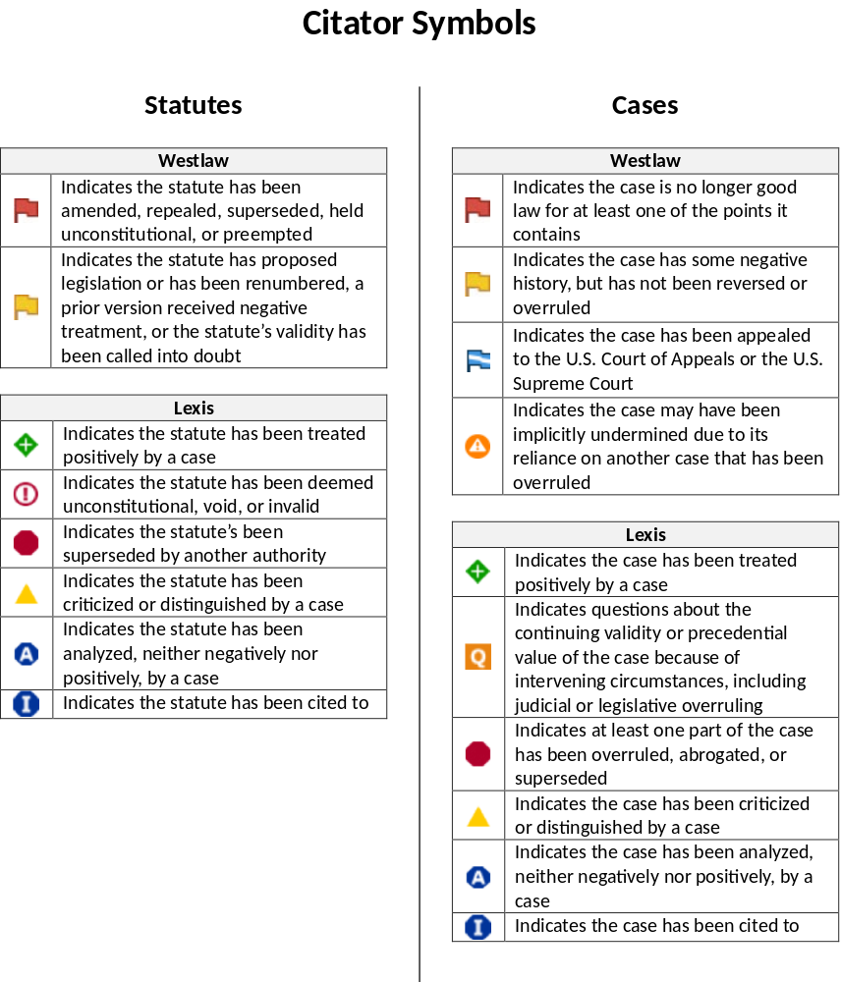

Slide 5

New Variation of A Westlaw Red Flag - A red-striped flag indicates that a case has been partially overruled and provides direct access to the specific language within the case that addresses the overruled point of law. For example, one identified point of law can be overruled while other points remain good law. It still means you need to review the negative history and see if the partial overruling applies to your issue.

Slide 6
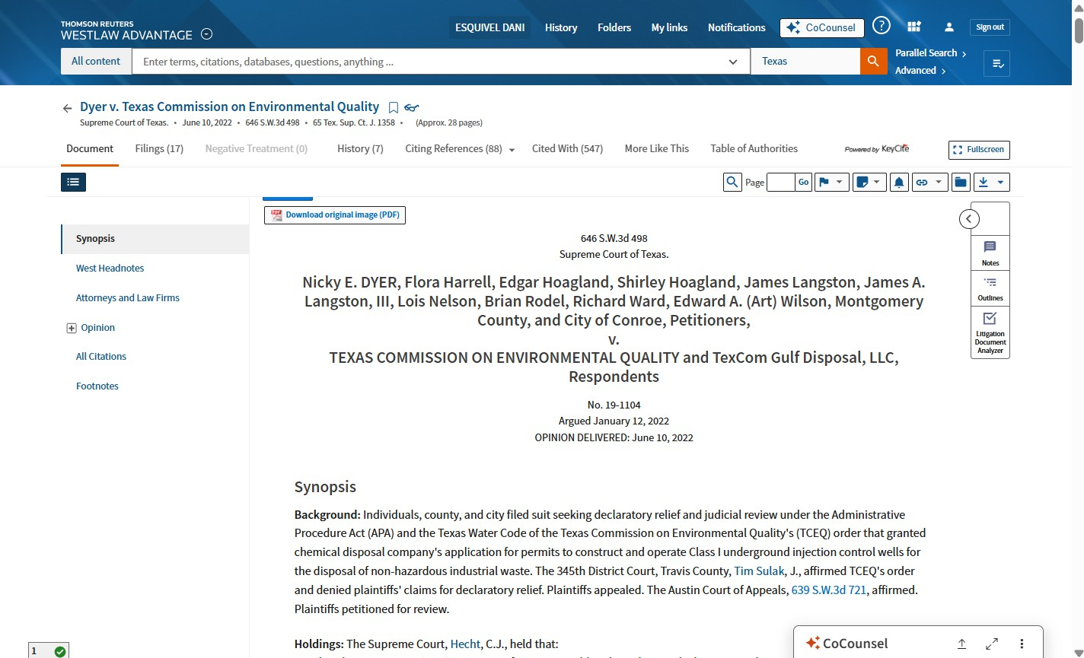
The Filings tab shows researchers the documents that were filed in the case.
The History tab shows researchers the prior and subsequent history of a case.
The Citing References tab lists all sources--including cases and secondary sources--that cite the case..
The Table of Authorities is a list of all the sources cited in the case.
Anatomy of a Case:
Westlaw
The Negative Treatment tab shows researchers the negative direct history and cases that cite the case negatively.
TThe Cited With tab lists cases that are often cited alongside the case.
The Case Citation tells researchers how to look up the case or find it in a print reporter. Here it’s 646 S.W.3d 498, which stands for page 498 of the 646th volume of the Southwestern Reporter Third.
A Docket Number is an independent number assigned to each case when it’s filed; this number attaches to all filings and court documents while the case is before the court.
The Argued Date is the date oral arguments were heard before the court.
The Opinion Delivered Date is the date the opinion was delivered or published.
The Synopsis provides a brief summary of the facts, the nature of the claim, the procedural stages in the history of the case, and the decision by the court.

Slide 7
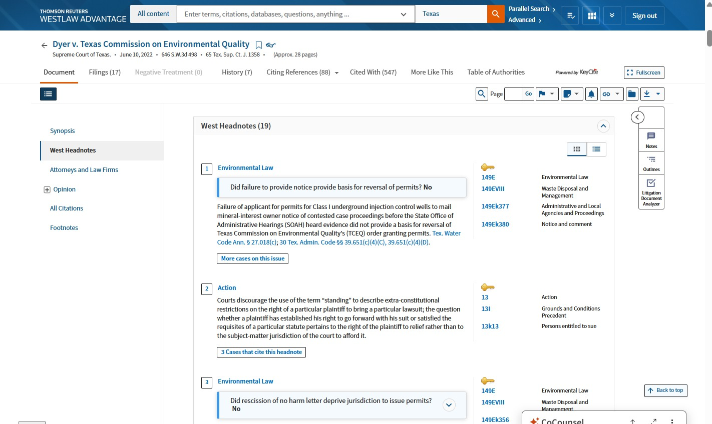
Anatomy of a Case:
Headnotes give summaries of sub-issues discussed in a case. Researchers can use headnotes to find where that issue was discussed in the case and to find more cases on that issue.
Westlaw

Slide 8
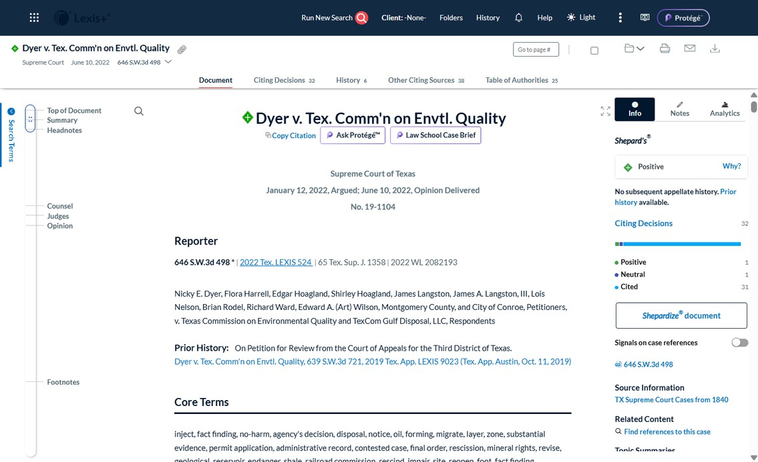
The Citing Decisions tab lists all the cases that cite the case.
Other Citing Sources lists all the non-case sources that cite the case.
The Shepard’s Report tells researchers how the case was treated by subsequent cases.
The Table of Authorities is a list of all the sources cited in the case.
Anatomy of a Case:
Lexis+
The History tab shows researchers the prior and subsequent history of a case.
The Opinion Date is the date the opinion was delivered or published.
The Argued Date is the date oral arguments were heard before the court.
A Docket Number is an independent number assigned to each case when it’s filed; this number attaches to all filings and court documents while the case is before the court.
The Case Citation tells researchers how to look up the case or find it in a print reporter. Here it’s 646 S.W.3d 498, which stands for page 498 of the 646th volume of the Southwestern Reporter Third.
The Core Terms lists important terminology used in the case.

Slide 9
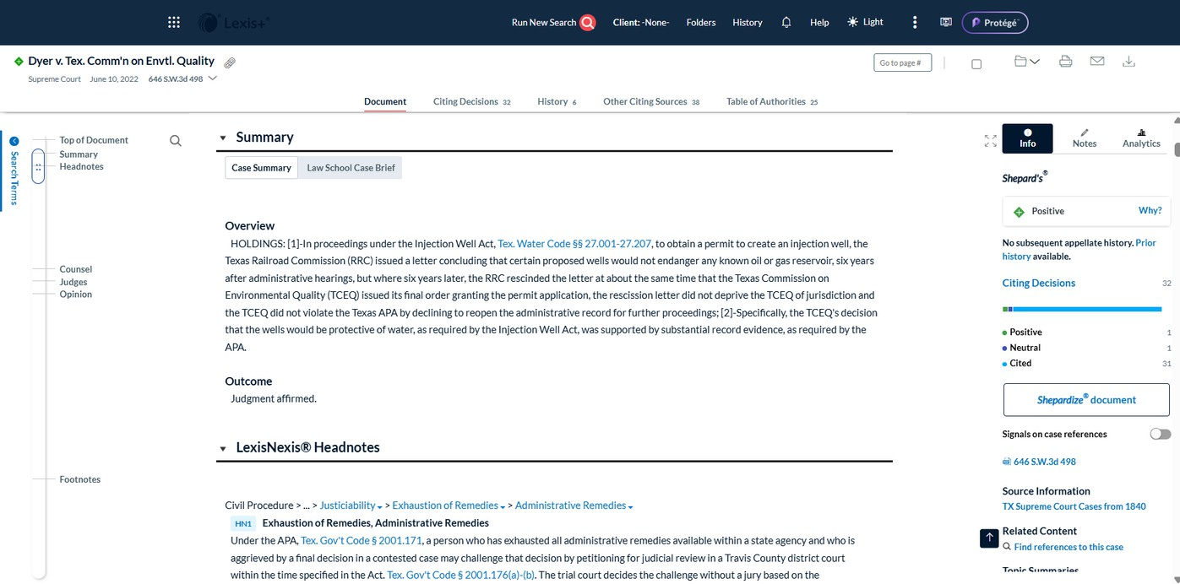
Anatomy of a Case:
Headnotes give summaries of sub-issues discussed in a case. Researchers can use headnotes to find where that issue was discussed in the case and to find more cases on that issue.
Lexis+
The case Summary provides a brief summary of the facts, the nature of the claim, the procedural stages in the history of the case, and the decision by the court.

Slide 10







Four-Step Legal Research Checklist
Step 1: Problem Analysis
Chart your problem using the Problem Analysis template
  Parties
  Places
  Things
  Potential Claims & Defenses
  Relief Sought
Use Facts to Legal Language Checklist to find legal language
Identify the broad legal areas you need understanding of
Step 2: Issue Analysis
Select a secondary source to begin your research—usually an encyclopedia!
  See Secondary Source Flipcards for a review of secondary sources.
Look up core concepts in index or table of contents of legal encyclopedia to gain important background and identify specific legal research issues
  Go to “general” sections first
  Check nearby sections of encyclopedia for more relevant information on your issues and read at least first few sentences of all sections that seem relevant
  Take note of primary sources cited within the sections you read
Select a good legal treatise
  To find a good national legal treatise, use the Georgetown Treatise Finder and select one marked as preeminent
  For a good Texas legal treatise go to our Texas Treatise Finder
  I all else fails, ask a librarian
Look up core concepts in index or table of contents of legal treatise to deepen your understanding of legal issues
  Take note of primary sources cited within
By the end of this step, you should know the specific research issues you need to dig into more deeply
Step 3: Statutory Analysis
Review the Anatomy of a Code for a refresher on the different tools (remember, you must download it in Google Chrome to see the pop-ups!)
Read the statute(s) to determine its relevance to your research issues: your secondary sources should direct you here, but you could also use the index or table of contents to find relevant statutes if necessary.
Ensure your statute is still good law (see Citator symbols here)

Slide 11

Look Around to give yourself context
  Captions/Headings
  Table of Contents: remember, we are keeping a particular eye out for definitions sections, but also any other relevant sections
Look Backwards
  Statutory History Line: when was statute enacted/last amended
  Legislative History: see a librarian if you need to do this!
Look Forwards
  Notes of/to Decisions: the cases the attorney-editors at Westlaw/Lexis have selected as being the most helpful in interpreting the language of the statute.
    Check mini Table of Contents in NoD to see if your specific issues are there
  Citing References/Citing Decisions: all cases that cite your statute; use filters to get to binding cases on your issues
  Context & Analysis (WL only): other sources that don’t cite your source that WL thinks may be helpful
  Other Citing Sources (Lexis only): other sources that cite your statute
Step 4: Case Analysis
Review the Anatomy of a Case for Westlaw and Lexis for a refresher on the different tools (remember, you must download it in Google Chrome to see the pop-ups!)
Skim the case to determine its relevance to the specific issue you’ve identified
Ensure case is still good law (see Citator symbols here)
Use the Any Good Case Method to find more binding cases on your issue
  Identify the relevant headnotes for each of the research issues you’ve identified
  Look Backwards: click at headnote number & look at cases cited within your case (looking backward in time at cases your case is building on)
  Look Forwards: go to Citing References/Citing Decisions and look at
cases that have cited your case on your issue (use the filters to find binding cases that discuss your issue)
  Look Side-to-Side: use Topic & Key Numbers (WL) or headnotes (Lexis) to find all cases discussing the same issue you’re working on
Remember: you’ll repeat many of these steps again and again, as you work through all your specific sub-issues, and you’ll do the Any Good Case method especially over and over until you start coming across the same cases again and again.
Stop by the reference desk, the research fellows’ office hours, or email Prof. Drake at adrake2@central.uh.edu for help with your research!

Slide 12
Homework
Complete Legal Research Modules 4.5 -4.9 by CLASS TIME Tuesday, 10/6
Graded Research Assessment, In-Class Thursday, 10/8

